Slide 1



KONGU ENGINEERING COLLEGE
Department of Computer Technology – PG
M.Sc (Software Systems)
20ISP61-MINI PROJECT
INVENTORY MANAGEMENT & E-COMMERCE APPLICATION FOR GHEE FACTORY
GUIDED BY,
Ms.K.Karthika
Assistant Professor
Department of CT-PG
PRESENTED BY,
JEYA BALAJI C K 21ISR019
NITHAN S 21ISR029
VEDHA DHARSHINI R 21ISR054
M.Sc Software Systems (3^{h} Year)

Slide 2
OBJECTIVE
The objective is to establish a robust online platform enabling easy access to premium-quality ghee products through a user-friendly website interface.
The initiative aims to enhance customer satisfaction, promote the convenience of online ghee shopping, and elevate the overall quality of the purchasing process.

Slide 3
EXISTING SYSTEM
The company relies on manual processes for product selling.
The company should need to meet the client directly to get the order details.
The billing processes are also managed manually.

Slide 4
PROPOSED SYSTEM
It establish a strong stock management system to effectively oversee and control inventory levels, avoiding shortages and excesses
It enables a user-friendly and responsive e-commerce website, facilitating effortless online product exploration and purchasing
It brings automated billing system to streamline financial transactions, ensuring accuracy
It enables customers to track the real-time status and location of their deliveries

Slide 5
MODULES
Stock Management
E-commerce Integration
Billing System
Delivery Tracking

Slide 6
1.STOCK MANAGEMENT
Inventory Categorization
Raw Ingredients
Packaging Materials
Finished Product
Mobile Accessibility
Mobile stock Monitoring
Track Expiry Dates

Slide 7
2.E-COMMERCE
Product Catalog
Product Image Upload
Product Description
Order Processing and Fulfillment
Online Order Processing
Order Fulfillment
Shipping Management
Customer Account Management
User Registration
Customers Profiles

Slide 8
3. BILLING SYSTEM
Invoice Generation
Payment Transaction
Track Payment
Real Time Update
Discounts and Promotion
Applying Discounts,Coupon Code
Invoice Communication
Notification for successful payment
Refund Processing

Slide 9
4.DELIVERY TRACKING
Shipment Initiation
Real-Time Tracking
Delivery Route Optimization
Minimizes delivery time
Proof of Delivery (POD)
Electronic Signatures

Slide 10
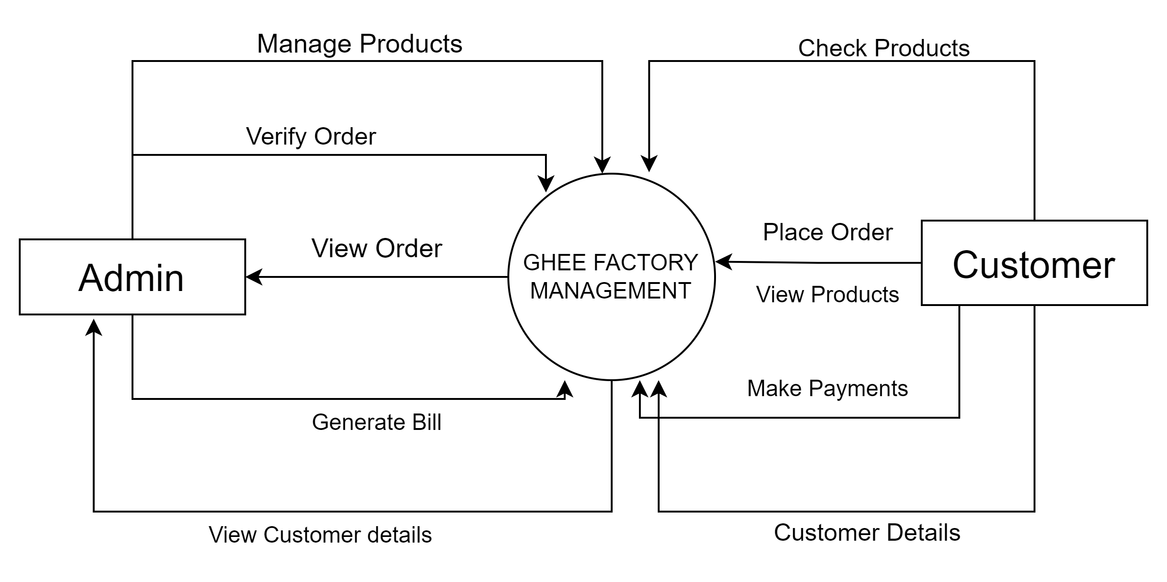
DATA FLOW DIAGRAM LEVEL - 0

Slide 11
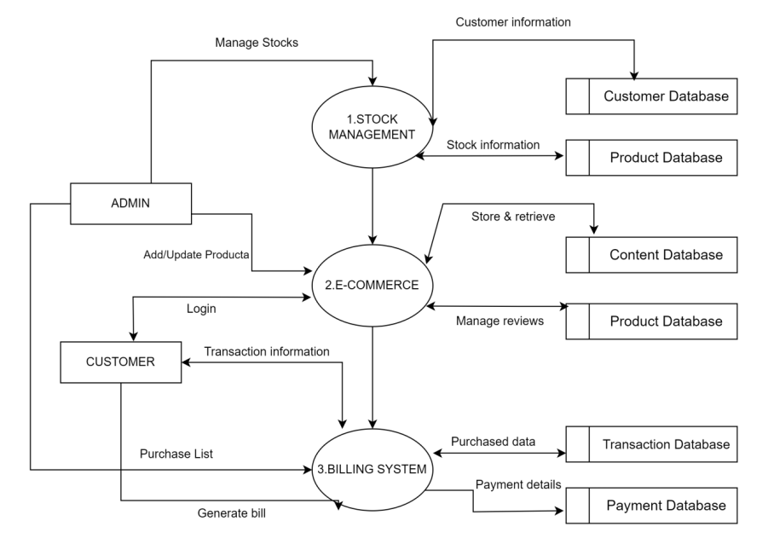
LEVEL - 1

Slide 12
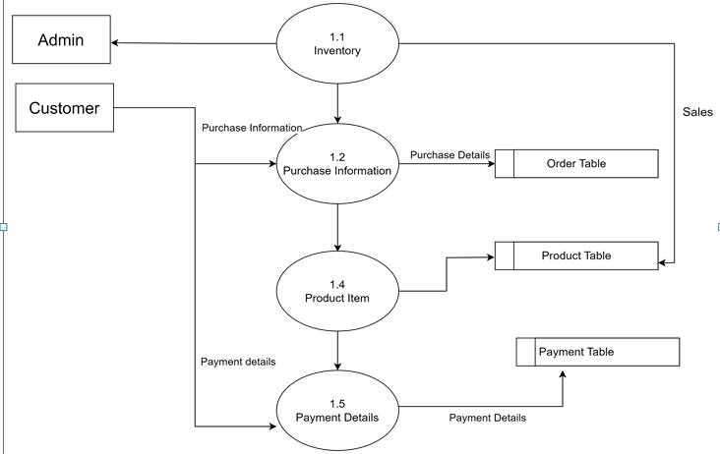
LEVEL – 2 (Stock Management)

Slide 13
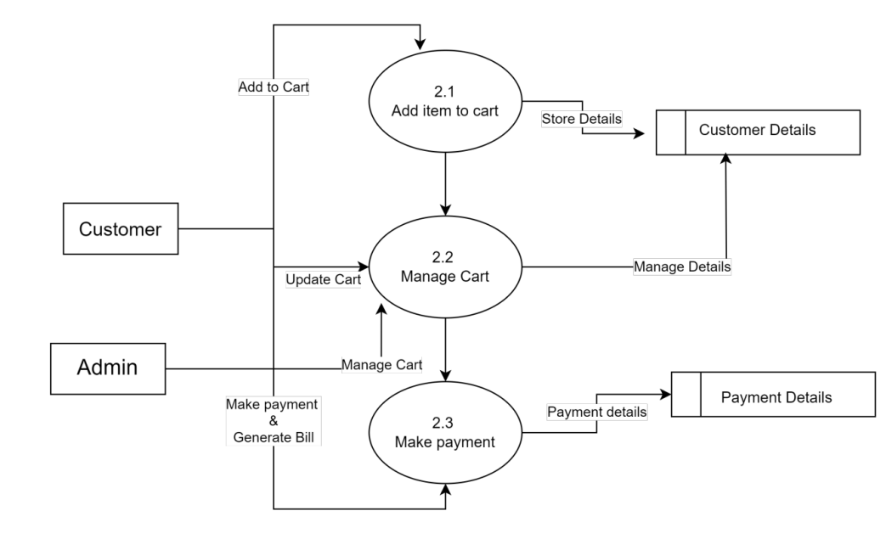
LEVEL – 2 (E-Commerce)

Slide 14
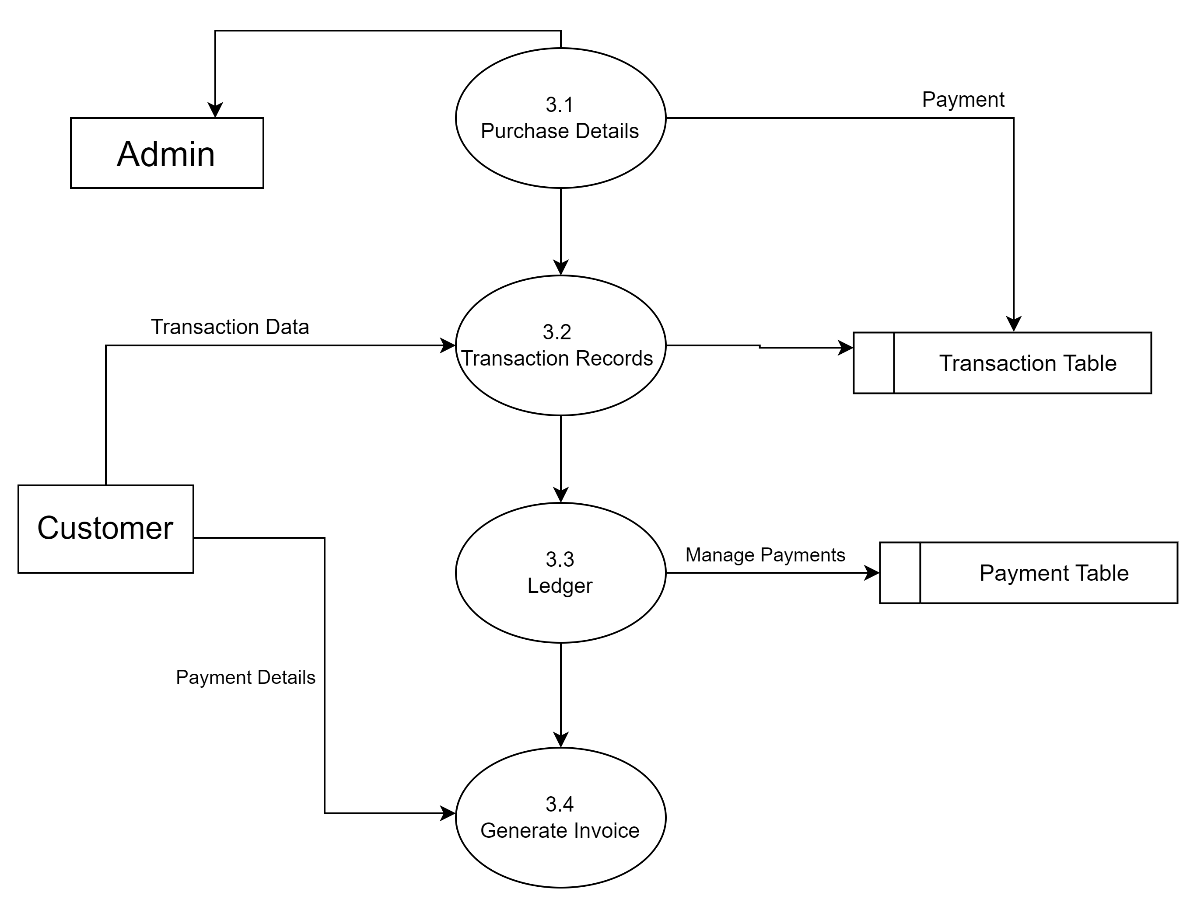
LEVEL – 2 ( Billing System)

Slide 15
TABLES
Brands
Order_Item
Category
User
Product
Order

Slide 16
BRANDS
FIELD NAME | DATA TYPE | SIZE | CONSTRAINTS
Brand_id | Int | 11 | Primary Key
Brand_Name | Varchar | 20 | Not Null
Brand_status | Int | 11 | Not Null
ORDER_ITEM
FIELD NAME | DATA TYPE | SIZE | CONSTRAINTS
Order_item_id | Int | 11 | Primary Key
Quantity | varchar | 20 | Not Null
Rate | Varchar | 20 | Not Null
Total | Varchar | 20 | Not Null

Slide 17
CATEGORY
FIELD NAME | DATA TYPE | SIZE | CONSTRAINTS
Category_id | Int | 11 | Primary Key
Category_Name | Varchar | 20 | Not Null
Category_status | Int | 11 | Not Null
USER
FIELD NAME | DATA TYPE | SIZE | CONSTRAINTS
User_id | Int | 11 | Primary Key
User_name | Varchar | 20 | Not Null
Email | Varchar | 20 | Not Null
Password | Varchar | 20 | Not Null

Slide 18
PRODUCT
FIELD NAME | DATA TYPE | SIZE | CONSTRAINTS
Product_id | Int | 11 | Primary Key
Product_Name | Varchar | 20 | Foreign Key
Product_image | text | - | Not Null
brand_id | Int | 11 | Primary Key
Catehories_id | Int | 11 | Not Null
Quantity | Varchar | 20 | Not Null
Rate | Varchar | 20 | Not Null
Price | Double | 5 | Not Null
Status | Int | 11 | Not Null

Slide 19
ORDER
FIELD NAME | DATA TYPE | SIZE | CONSTRAINTS
Order_id | Int | 11 | Primary Key
Order_date | date | - | Not Null
Client_name | Varchar | 20 | Not Null
Client_contact | Varchar | 20 | Not Null
sub_total | Varchar | 20 | Not Null
vat | Varchar | 20 | Not Null
Total_amount | Varchar | 20 | Not Null
Discount | Varchar | 20 | Not Null
Grand_total | Varchar | 20 | Not Null
Paid | Varchar | 20 | Not Null
Due | Varchar | 20 | Not Null
Payment_type | Int | 11 | Not Null
Payment_status | Int | 11 | Not Null
order_status | Int | 11 | Not Null

Slide 20
THANK YOU

